Slide 1
LOAD BALANCER
A load balancer is a networking device or software application that distributes and balances the incoming traffic among the servers to provide high availability, efficient utilization of servers, and high performance.
A load balancer works as a “traffic cop” sitting in front of your server and routing client requests across all servers.
It worked based on Layer 4 (Transport layer) and Layer 7 (Application Layer).

Slide 2
Types of load balancer
Application Load Balancer
Application Load Balancer when you need a flexible feature set for your applications with HTTP and HTTPS traffic.
Network Load Balancer
Network Load Balancer when you need ultra-high performance, TLS offloading at scale, centralized certificate deployment, support for UDP, and static IP addresses for your applications.
Gateway Load Balancer
Gateway Load Balancer when you need to deploy and manage a fleet of third-party virtual appliances.

Slide 3
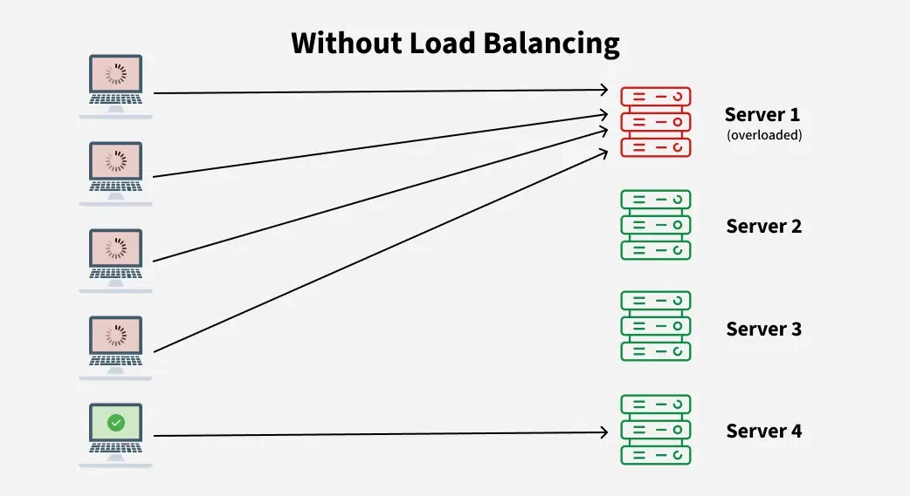
EXPLAINATION
What will happen if there is NO Load Balancer?
There are three main problems with this model:
Single Point of Failure:
Overloaded Servers:
Limited Scalability:

Slide 4
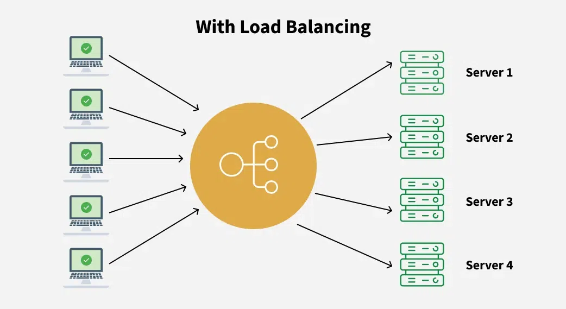
With Load Balancer:
Key characteristics of Load Balancers:
Traffic Distribution:
High Availability:
Scalability:
Health Monitoring:
How Load Balancer Works?
Receives Incoming Requests:
Checks Server Health:
Distributes Traffic:
Handles Server Failures:
Optimizes Performance:

Slide 5
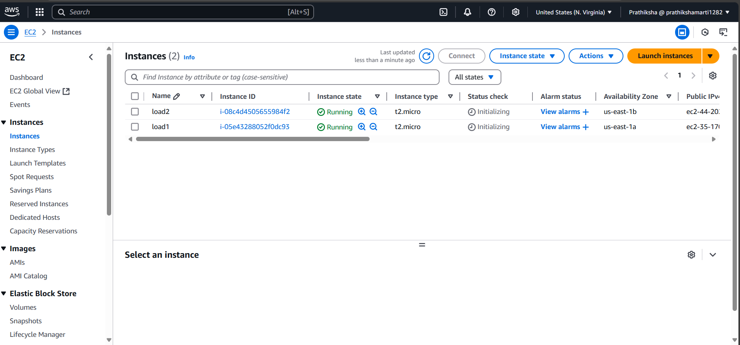
WORKING

Slide 6


Slide 7
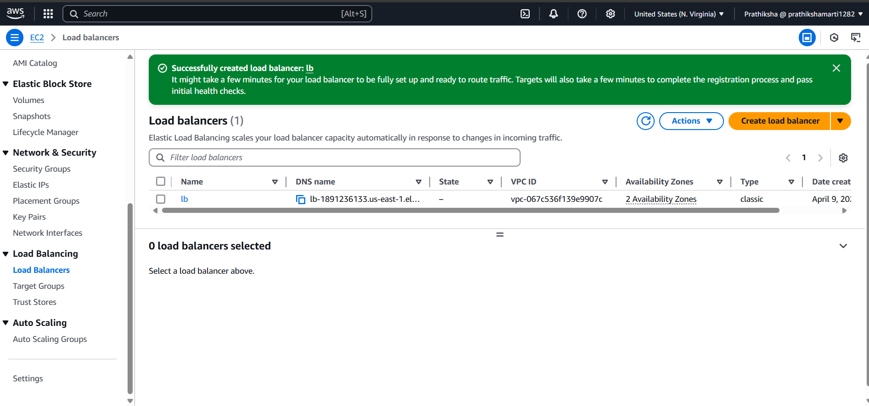

Slide 8
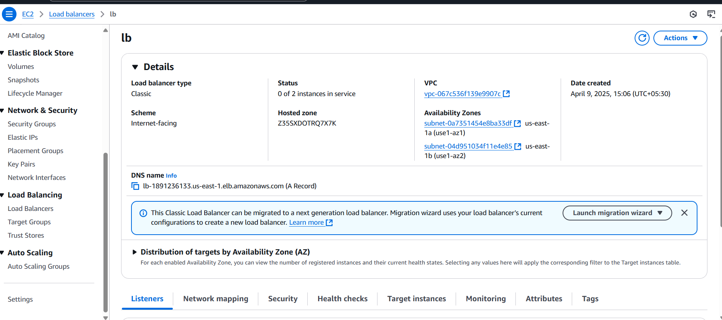

Slide 9


Slide 10


Slide 11
Benefits of using a Load Balancer:
Increases performance:
Increase Scalability:
Efficiently manages failure:
Prevent Traffic Bottleneck:
Case study:
“Second Spectrum reduces Kubernetes hosting costs using AWS load balancing services”
Second Spectrum provides artificial intelligence–driven tracking technology to modernize the way people engage with live sports broadcasts, including those of the National Basketball Association (NBA), Major League Soccer (MLS), and the Premier League (EPL).
“Kubernetes is a beast to wrangle,” senior director of infrastructure at Second Spectrum. “Because there are so many moving parts, it is extremely time consuming to understand and manage Kubernetes internals in house. Application Load Balancer operates at the request level (layer 7), routing traffic to targets like containers or internet protocol addresses. Because of that they reduced Kubernetes hosting costs by 90%,Expects to reduce error rate by 75% and Improved application response time by 5 ms per request.

Slide 12
Conclusion
An Application Load Balancer supports HTTPS termination between the clients and the load balancer. Cloud load balancing ensures distributing your site's traffic to available servers effectively. It prevents downtime or machine breakdown issues while ensuring the applications are available to the client at all times.

Slide 13
THANK YOU

